Slide 1



Bank CRM Development Analysis
Himanshu Kumar Jha

Slide 2

Introduction
Welcome to the presentation of our analysis project, which seeks to enhance the bank's retention strategy by deepening our understanding of customer behavior. Leveraging data insights is crucial for staying competitive and ensuring sustained success in today's dynamic industry landscape, where customer loyalty is paramount. This project delves into various facets of customer interactions, financial behaviors, and demographic trends to extract actionable insights. By examining patterns of customer churn, spending behaviors, and responses to marketing efforts, our goal is to develop strategies that not only retain existing customers but also attract new ones.
Our project relies on a comprehensive dataset comprising customer information, transaction details, credit scores, and demographic profiles. Through advanced analytics and visualization techniques, we've unearthed valuable insights that will inform data-driven decisions to enhance customer satisfaction and drive business growth.
Join us as we embark on our data journey and delve into the insights that will shape our strategic initiatives moving forward.

Slide 3

Summary
"This project focuses on analyzing customer churn and retention within a bank, utilizing data-driven insights to reveal trends and patterns that impact customer behavior. Through the examination of demographics, account activity, and product usage, the project seeks to pinpoint high-risk customer segments and recommend tailored strategies to improve retention. Ultimately, the objective is to harness data analytics to enhance customer satisfaction, minimize churn rates, and foster sustainable growth for the bank."

Slide 4



Analytical Approach & Tools
Cleaning and formatting of data
I employed Excel for the initial stages of data cleaning, which involved tasks such as eliminating duplicates and ensuring consistent formatting across columns. Additionally, I conducted data profiling to gain insights into the structure of the dataset, detect patterns, and evaluate the quality of the data.
Storage and manipulation of data
I transferred the Excel data into an SQL database. I then conducted an analysis of customer churn by crafting SQL queries to establish correlations between customer attributes and churn rates.
Data Analysis and Visualization
I utilized both the queries and original files within Power BI to process the data. From there, I developed interactive dashboards aimed at showcasing balance details, churn rates, and customer information.

Slide 5





Overview of the Customers
Total Customers
Churn Rate
Average Credit Score

Slide 6
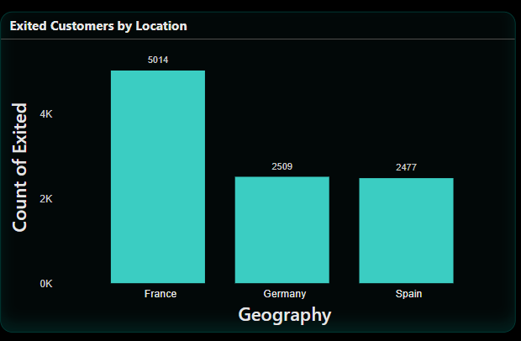
Churned Customers by Countries
The chart displays the count of customers who have exited based on their geographical location, specifically focusing on three countries: France, Germany, and Spain. The chart visually represents the number of exited customers in each country, with France having the highest count, followed by Germany and then Spain. The bars in the chart provide a clear comparison of the exit counts across the three countries, with France having the largest number of exited customers.

Slide 7
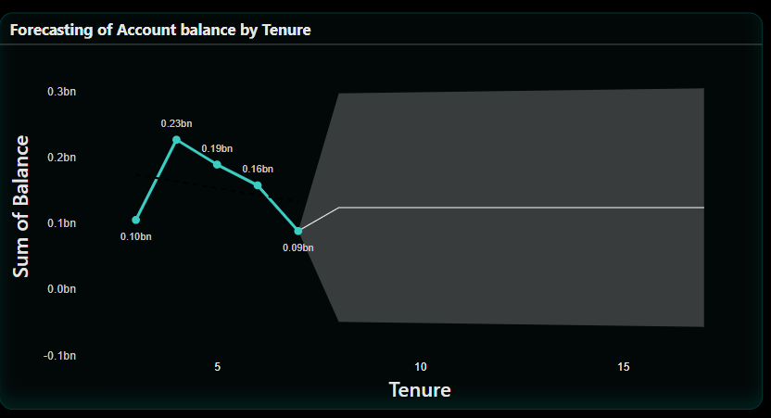
Forecasting of Account Balance
The graph illustrates the relationship between account tenure and the cumulative account balance, likely predicting future balances based on the account's duration. The data suggests that account balances typically increase during the initial years, experience a decline around the five-year mark, then recover slightly before stabilizing or slightly decreasing after approximately ten years. The shaded area indicates that the most accurate predictions are within the first ten years.

Slide 8
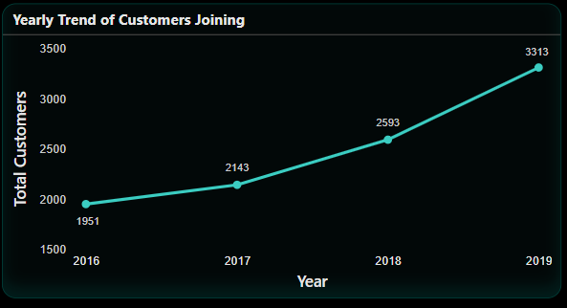
Yearly Trend of Customers Joining
The graph displays the number of customers who joined each year from 2016 to 2019. The X-axis represents the years, while the Y-axis shows the total number of customers. The data reveals a positive trend, with an increasing number of customers joining annually:
In 2016, there were 1,951 customers.
In 2017, this number rose to 2,143 customers.
In 2018, the total number of customers grew to 2,593.
By 2019, the number reached 3,313 customers.
A line connecting these data points illustrates the trend of customer growth over the four-year period, highlighting consistent and positive growth in customer acquisition each year.

Slide 9
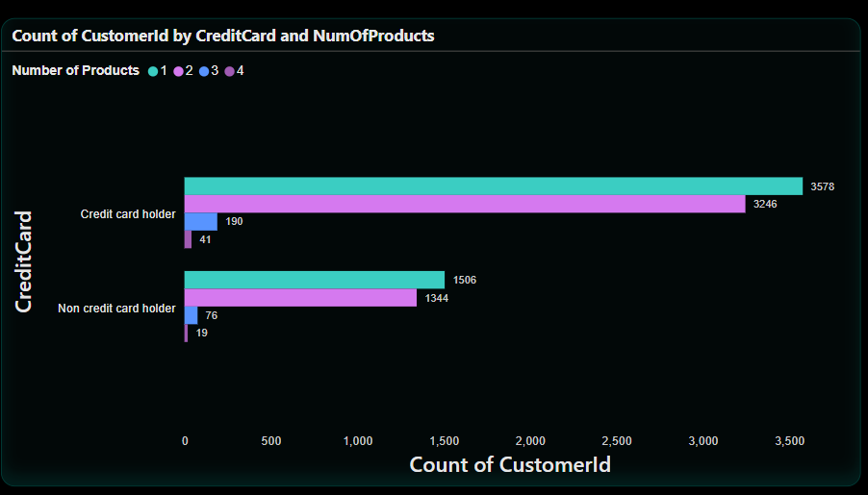
Count of Number of Products by Credit Card Status
The graph categorizes customers based on their credit card status and the number of products they hold (ranging from 1 to 4 products).
For credit card holders:
1 product: 3,578 customers
2 products: 326 customers
3 products: 41 customers
4 products: Not visible in the graph, likely 0 or a negligible number
For non-credit card holders:
1 product: 1,596 customers
2 products: 134 customers
3 products: 76 customers
4 products: 19 customers
This visual representation highlights the distribution of customers according to their credit card status and the number of products they own. It offers insights into customer segmentation and the prevalence of various product ownership levels among credit card holders and non-credit card holders.

Slide 10
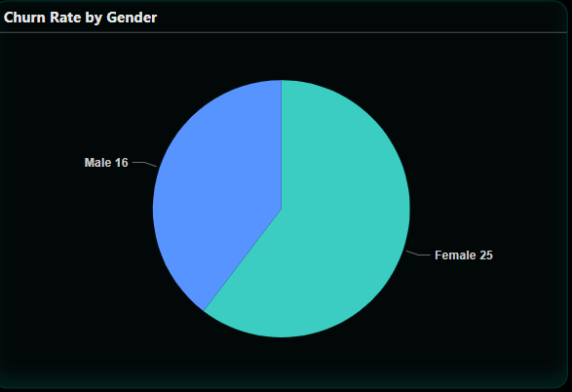


Churn Rate by Gender
The below PIE Chart displays the Churn Rates according to the Genders
16
25

Slide 11
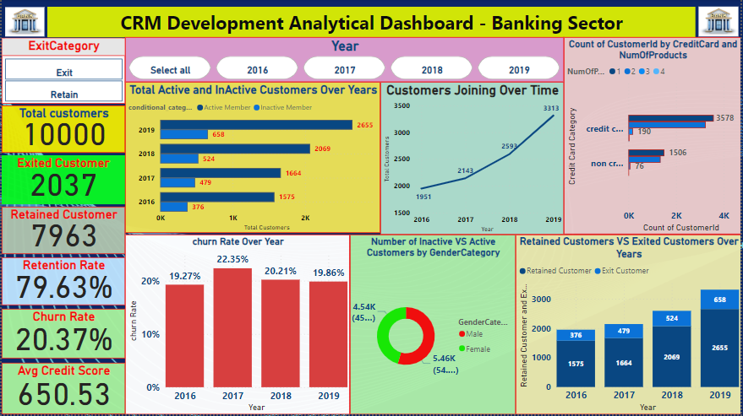
Dashboard and Visualizations

Slide 12
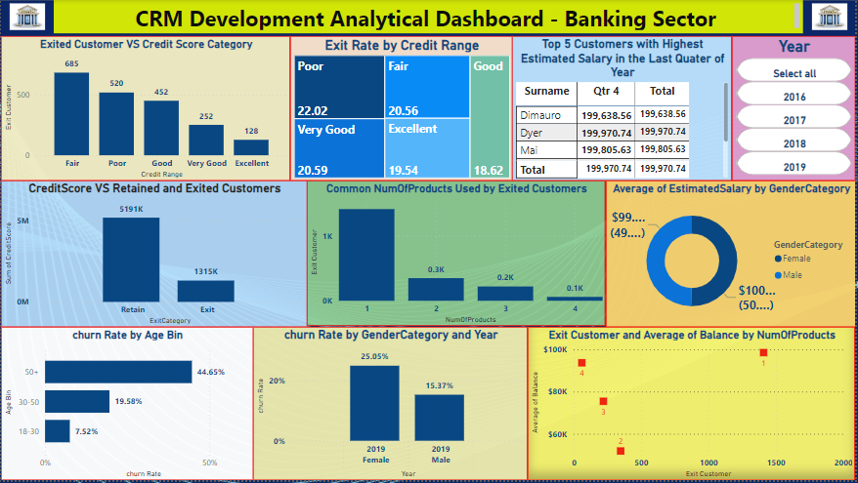
Dashboard and Visualizations

Slide 13
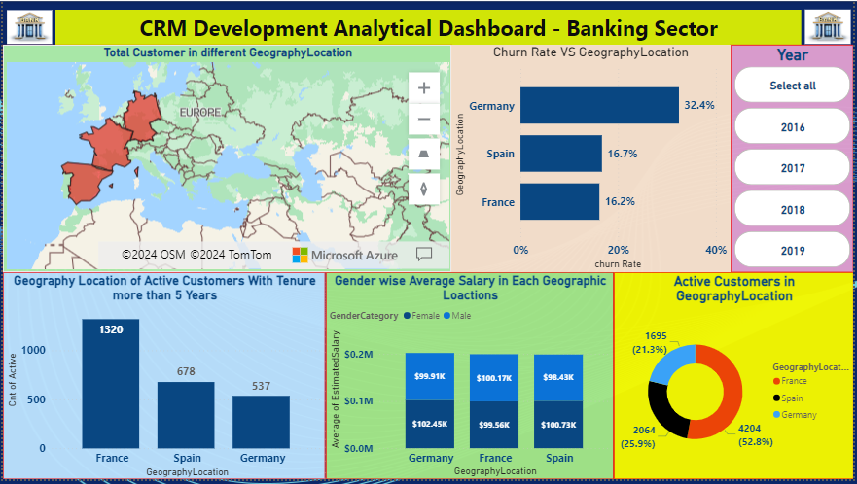
Dashboard and Visualizations

Slide 14
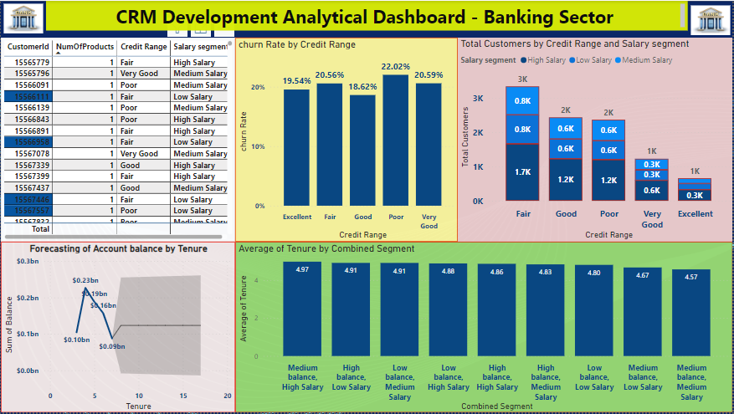
Dashboard and Visualizations

Slide 15
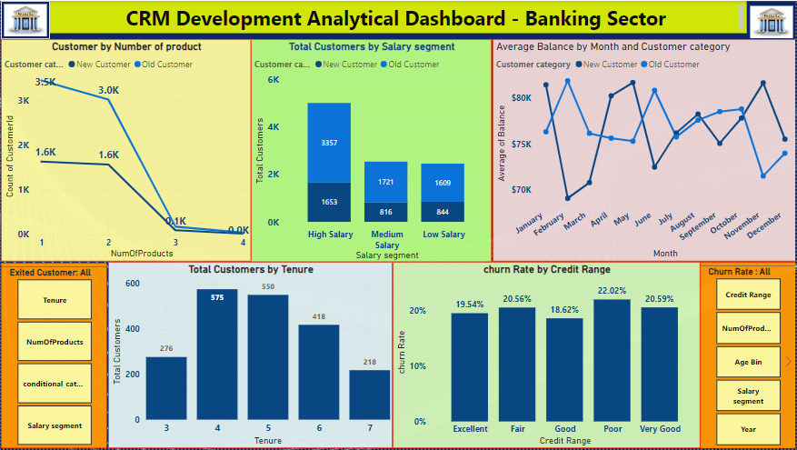
Dashboard and Visualizations

Slide 16
Conclusion
The project explored the complexities of customer churn analysis in the banking sector, providing valuable insights into customer behaviors, risk factors, and market trends. By identifying key metrics like churn rates, customer demographics, and product usage patterns, we were able to develop data-driven strategies for both customer retention and acquisition.
However, it is important to acknowledge that customer churn is a multifaceted issue influenced by numerous factors beyond our dataset, such as customer experiences, market competition, and economic conditions. While our analysis offers significant insights, a comprehensive approach that includes customer feedback, qualitative data analysis, and ongoing monitoring is crucial for achieving long-term success in reducing churn and improving customer satisfaction.

Slide 17



Thank you

